Slide 1


Case Study 5
Ensemble Techniques- Easy Visa.
Nafis Zafar

Slide 2
Objectives:
EDA (Exploratory Data Analysis
Build Decision Tree, Bagging classifier, and Random Forest - Comment on model performance
Comment on the model performance after tuning the Decision Tree, Bagging, and Random Forest classifier to improve the model performance.
Build Adaboost and GradientBoost - Comment on model performance * Please note building XGBoost model is optional
Comment on the model performance after tuning the AdaBoost, and Gradient Boosting classifier on the appropriate metric to improve the model performance - Build Stacking Classifier
Recommendation and actionable insights

Slide 3
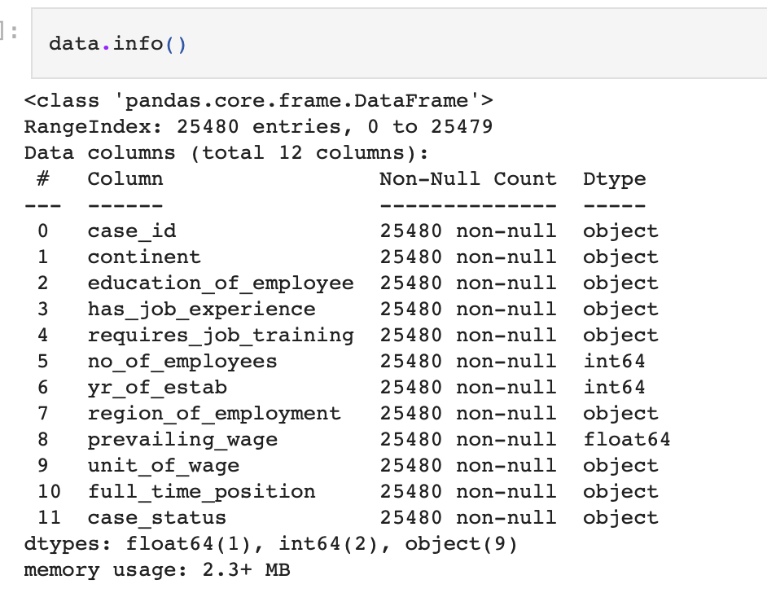
EDA (Exploratory Data Analysis)
There are 25,480 rows and 12 columns in dataset
The dataset has no null values
There are 3 numeric columns and 9 object (non numeric) data points

Slide 4
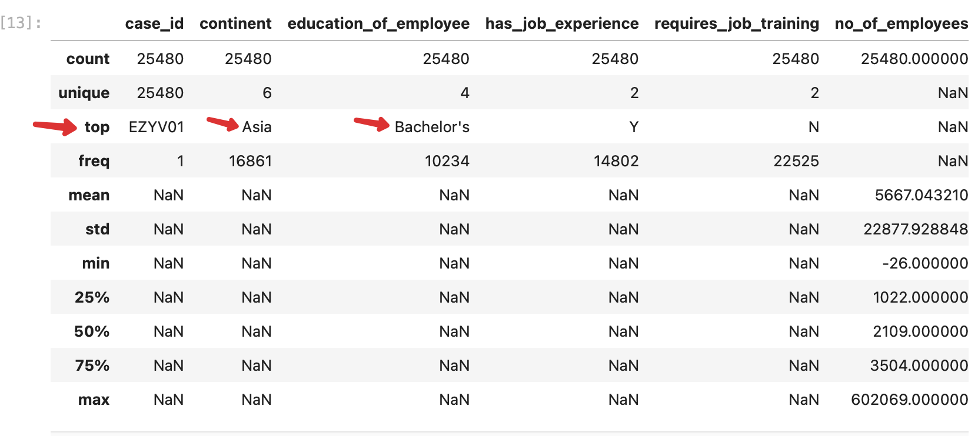
EDA (Exploratory Data Analysis)
Top continent is Asia with a frequency of 16861
Top education of employee is a bachelor's with a frequency of 10234

Slide 5
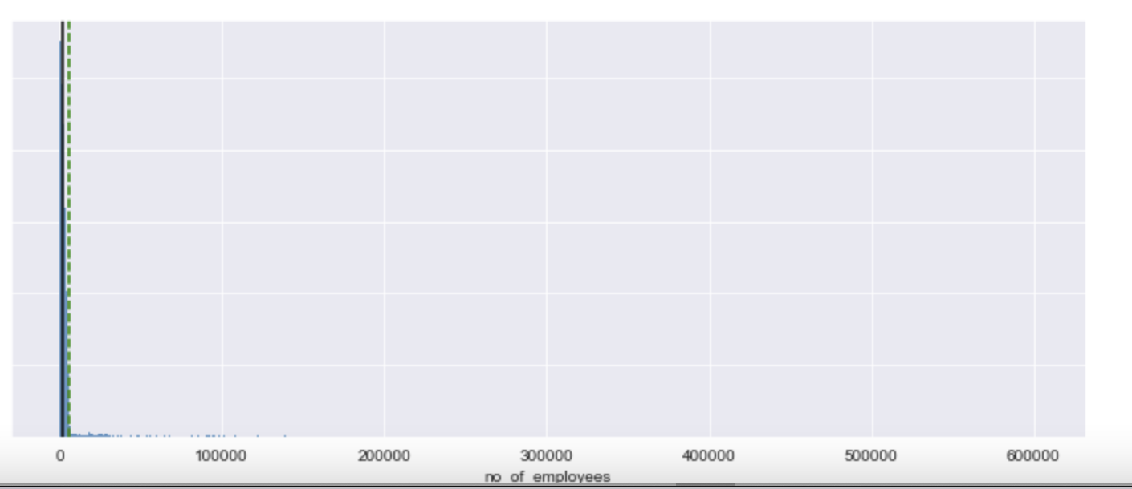
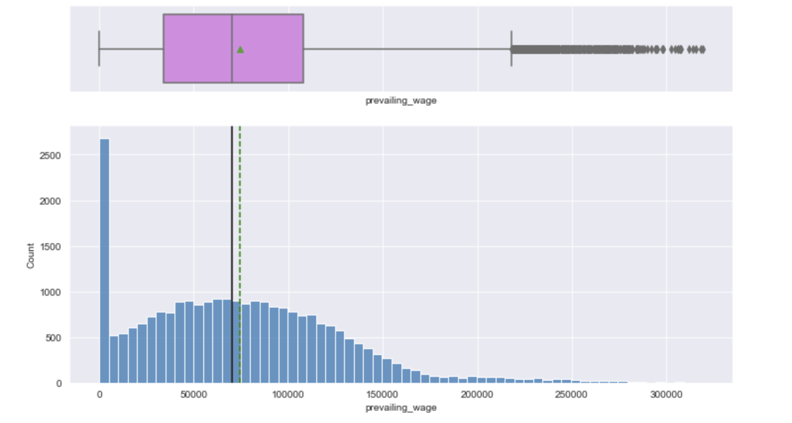
EDA (Exploratory Data Analysis)
There are 33 rows that has negative customer numbers
There are 2548 unique case IDs
number of employees shows a right-skewed distribution
Prevailing Wage shows right skewed distribution

Slide 6
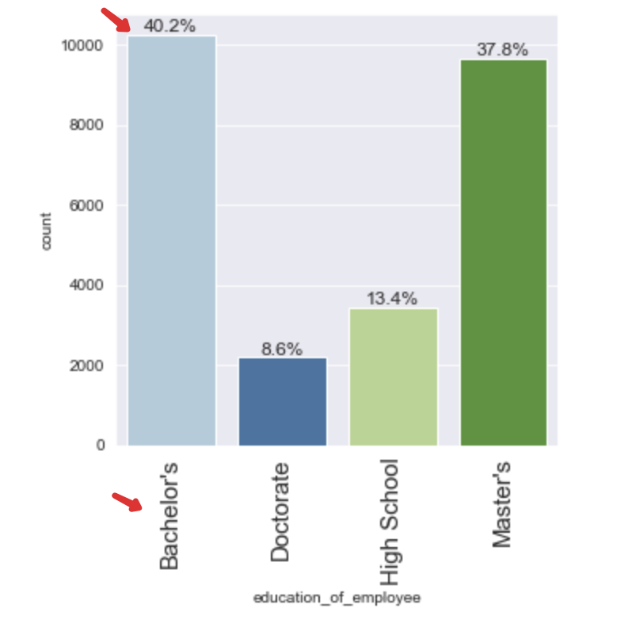
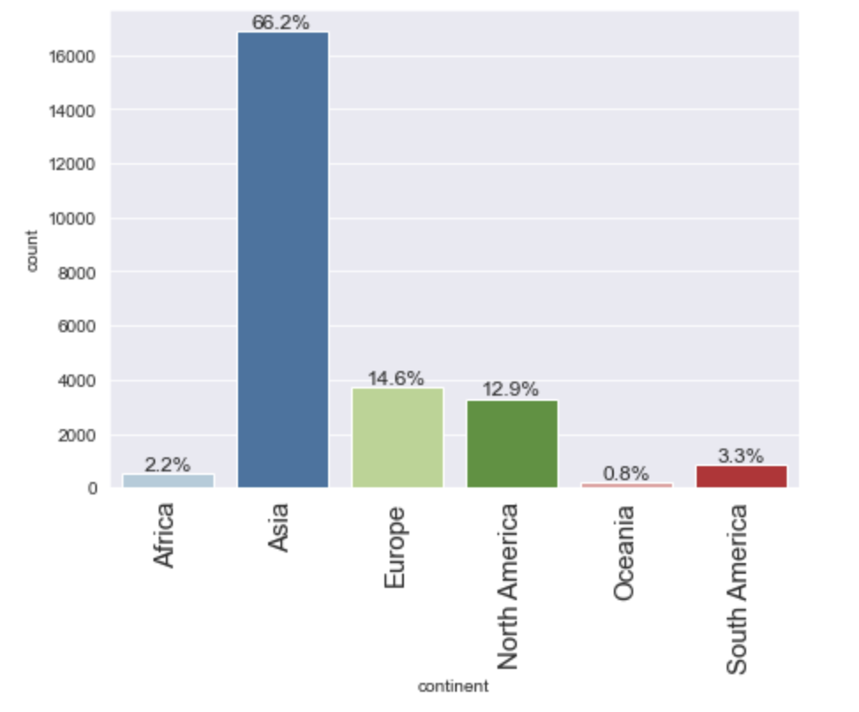
EDA (Exploratory Data Analysis)
176 observations have a prevailing wage lower than 100
Majority of applicants are from Asia
Majority of applicants have Bachlors degree, followed by Masters Degree

Slide 7
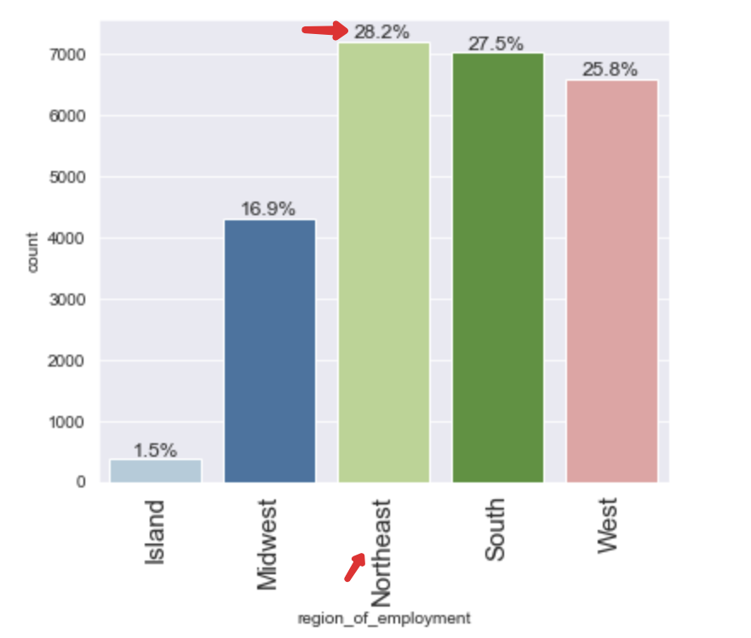
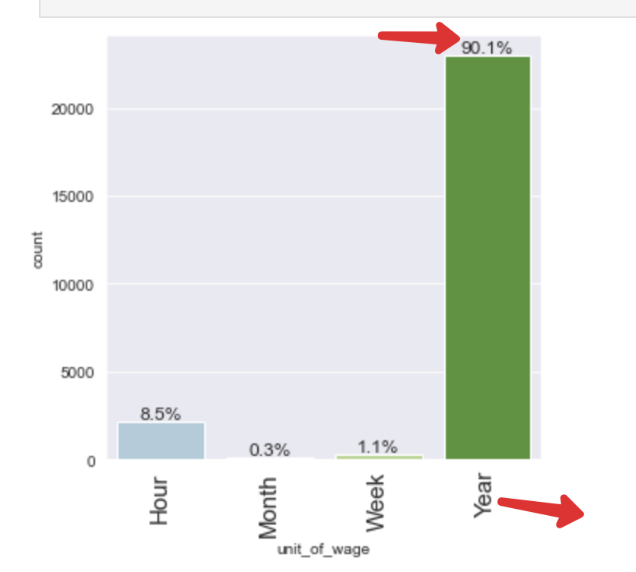
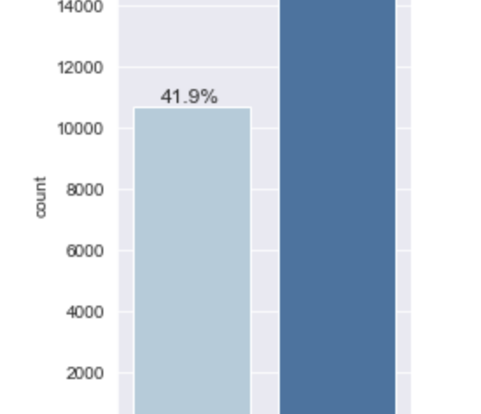
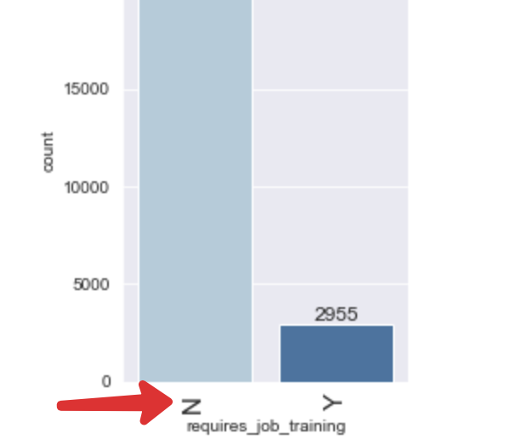
EDA (Exploratory Data Analysis)
Majority of applicants (58%) have job experience
Majority of applicants don’t need a job training (22k vs 3k)
Majority applicants are in north-east region
Mostly are on Annual Wage

Slide 8
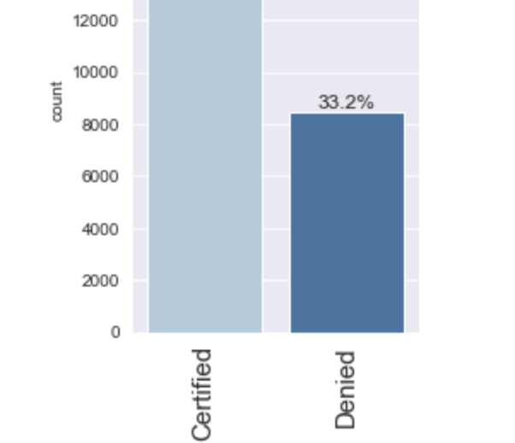
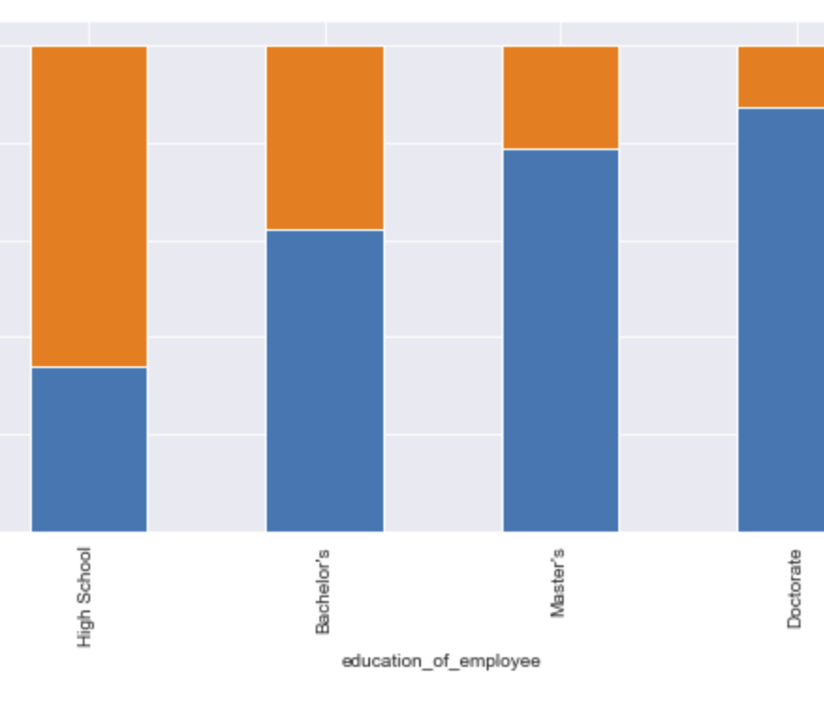
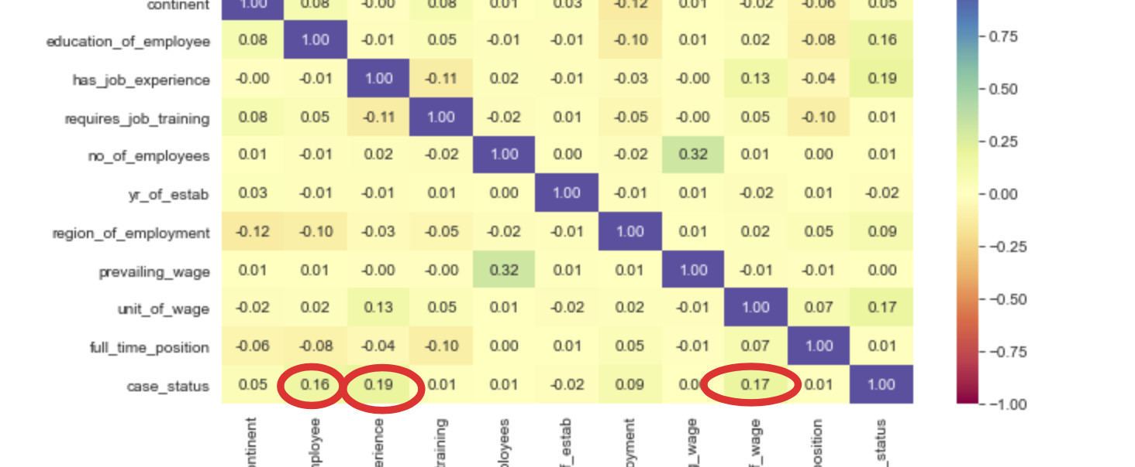
EDA (Exploratory Data Analysis)
Roughly 66% applicants are certified
Education, experience factors highly correlated to the case status
Education/degree increases the chance of certified VISA application

Slide 9
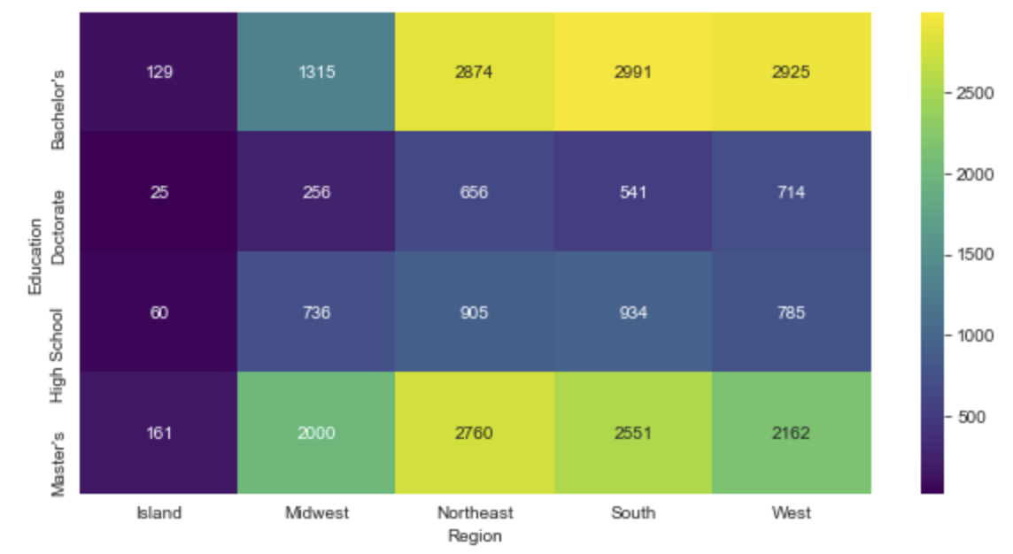
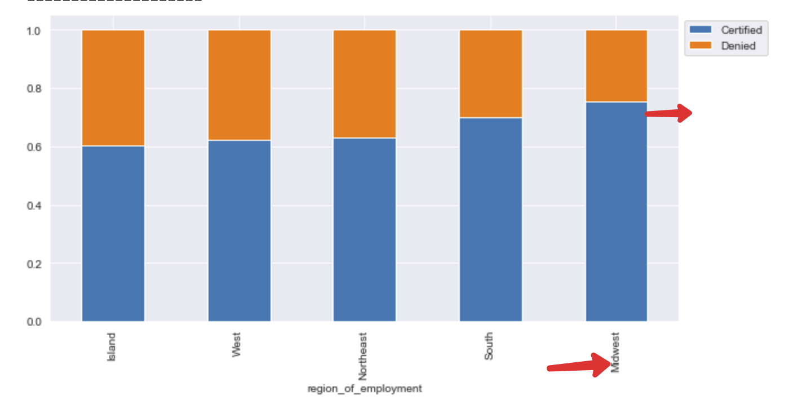
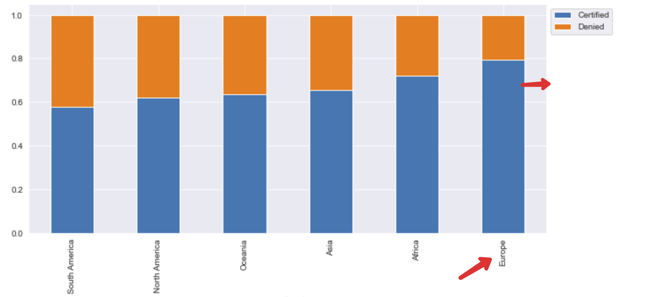
EDA (Exploratory Data Analysis)
Across the regions Bachelors and Masters hold highest population
The Midwest region has highest certified applications
Certified visa applicants are primarily from Europe

Slide 10
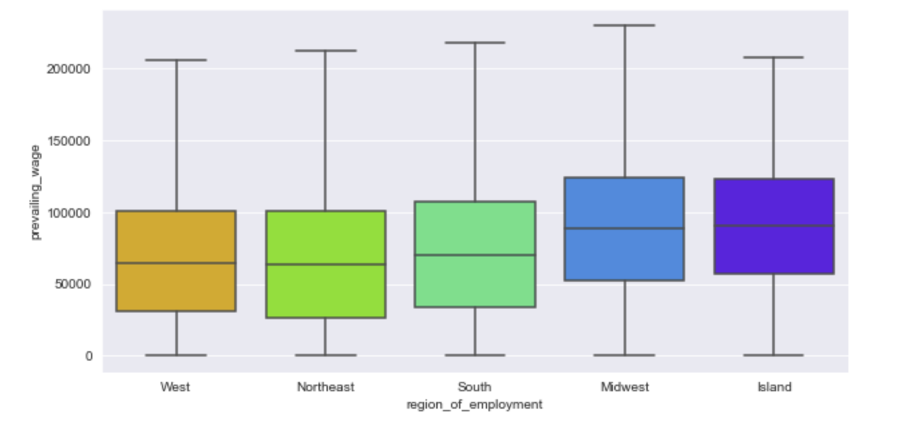
EDA (Exploratory Data Analysis)
Midwest and Island regions have the highest prevailing wages on average

Slide 11
Model creation
Evaluation Criteria: Model predicts that the visa application will get certified but in reality, the visa application should get denied, or will not get certified but in reality, the visa application should get certified.
Scenario: If a visa is certified US citizens will miss the opportunity to work on that position. If a visa is denied the U.S. will lose a suitable human resource that can contribute to the economy.

Slide 12
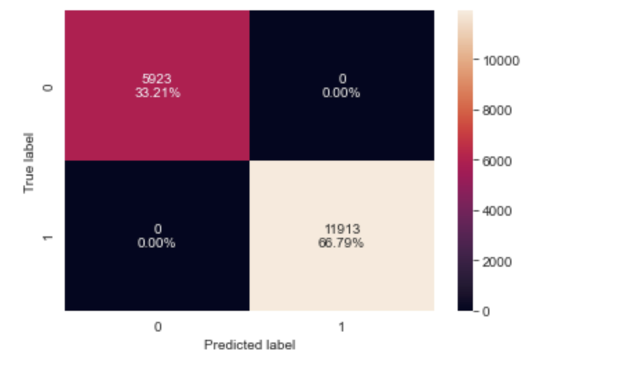
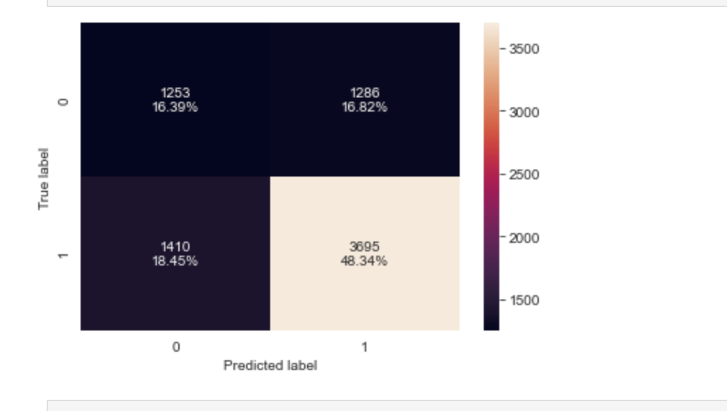
Check Model performance on training set and test set

Slide 13
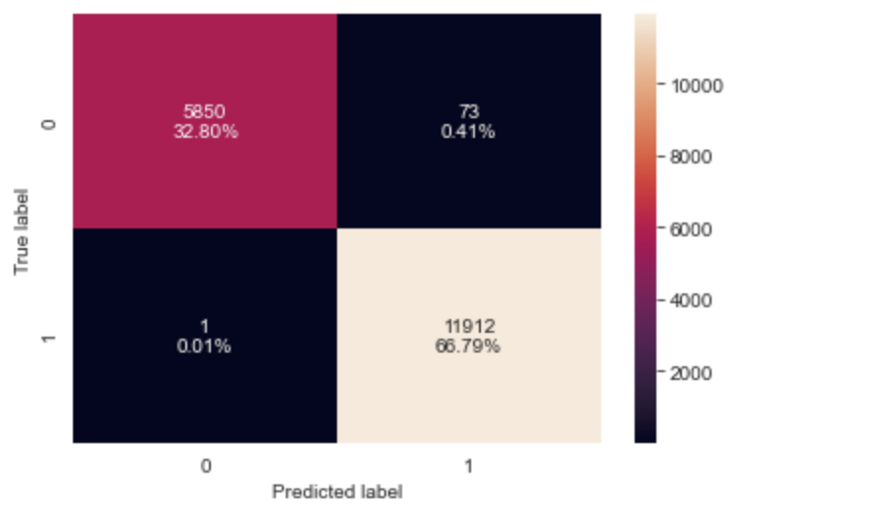
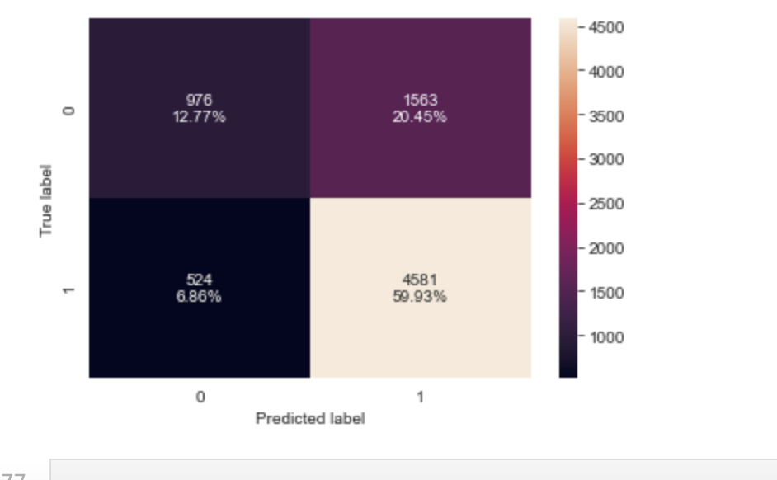
Bagging classifier use: Train and Test Model
The tuned bagging model is overfitting training data and has a higher F1 score than the default bagging model.

Slide 14
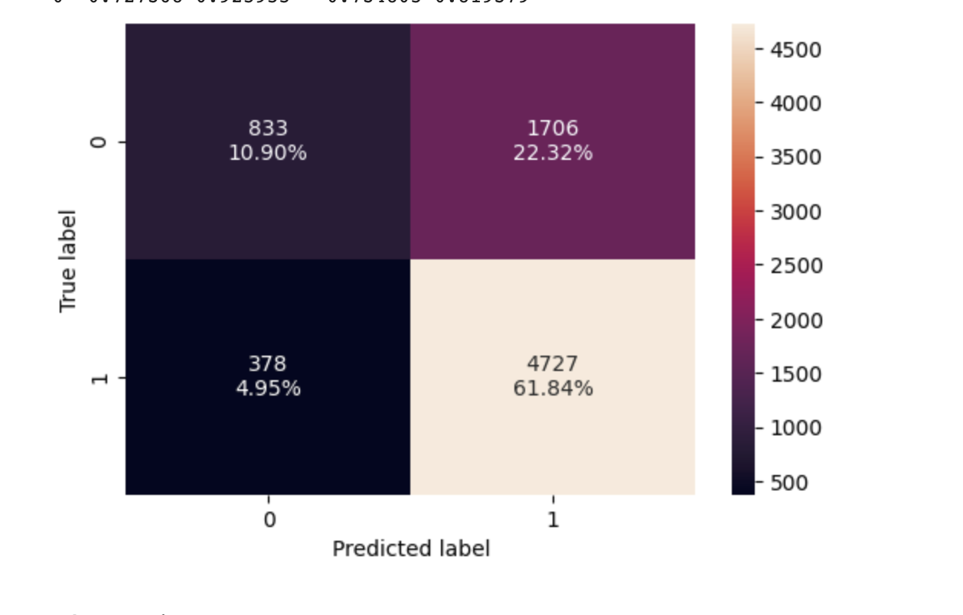
RainForest Model
Hypertuned RainForest Model performed well on both the training and test data sets

Slide 15
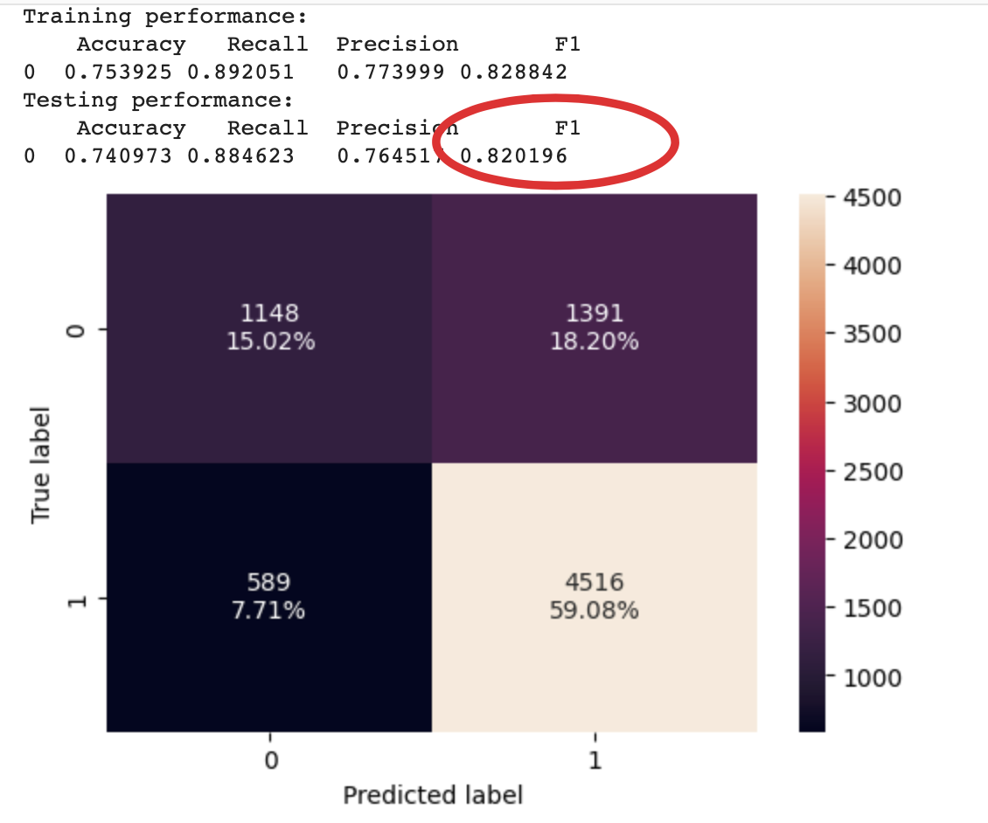
Hyperparameter Tuning - AdaBoost Classifier
The Hyper-tuned AdaBoost model is :
performing well between both the training and test data sets.
not showing any signs of overfitting.
has an approximate F1 score of .82
Yes, hyperparameters many times will improve the model performance. Additionally, hyperparameter tuning helps prevent overfitting issues.

Slide 16
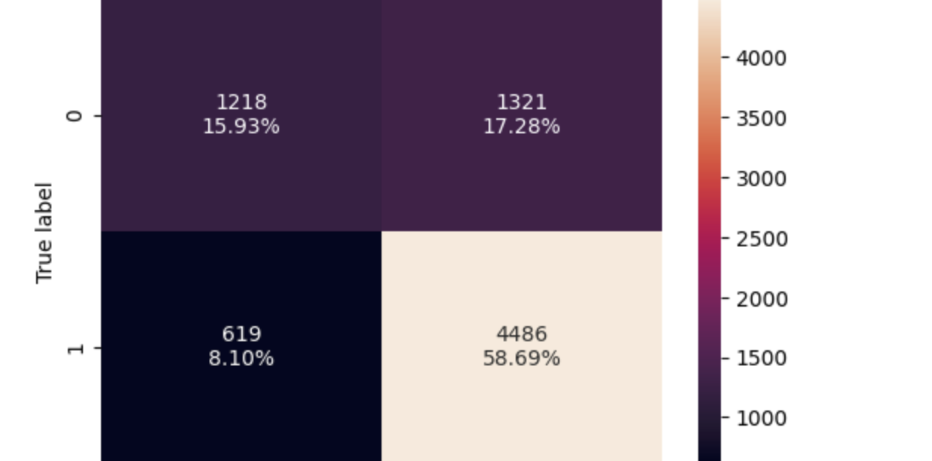
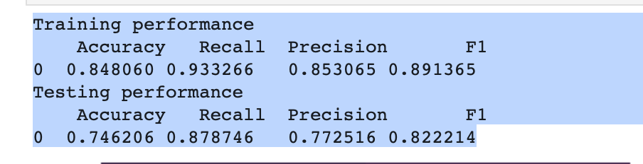
XGBoost Classifier
XGBoost classifier model was selected AS THE MOST FAVOURABLE since it had consistent performance metrics for both training and test data.
The tuned XGBoost classifier model had one of the highest F1 scores of approximately 0.832.

Slide 17
Final Recommendation
Based on Bivariate analysis it proves that additional information such as the applicant skill sets or profession is key to make impact on visa. This additional information will helps in deeper analysis and understanding on why the normalized yearly wages of employees are so high. So, please collect accurate and more analytical data on these areas.

